Slide 1

Engagement Analysis
by Gabriel Guerra & Alexandre Da Silva

Slide 2
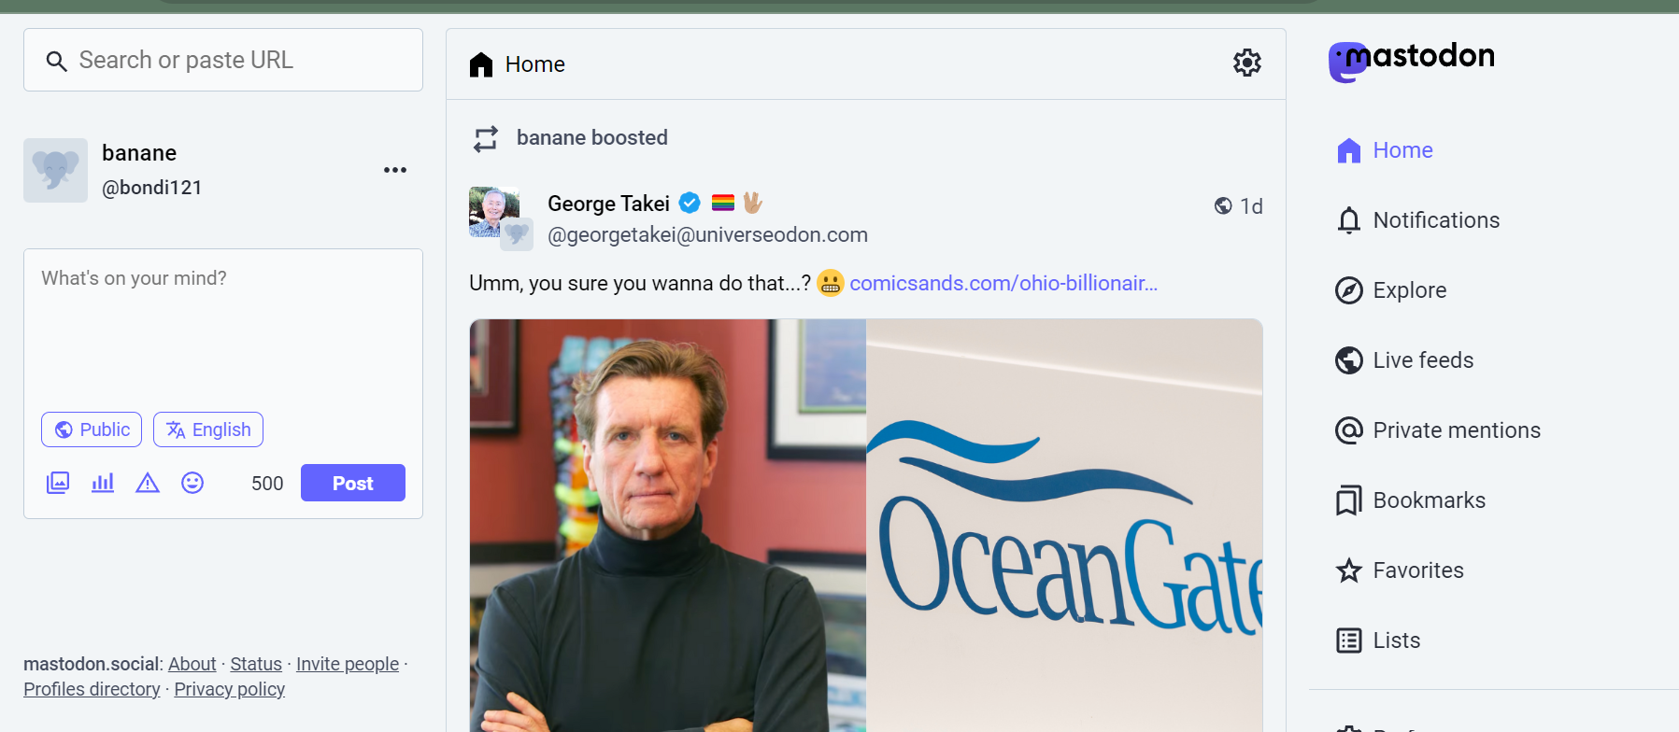
What is Mastodon?
Decentralized & Open Source Social Network

Slide 3
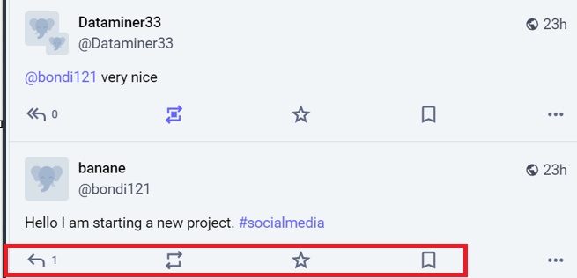
Engagement analysis
We selected the top profiles
Amount of post replies, shares & likes as engagement indicators

Slide 4
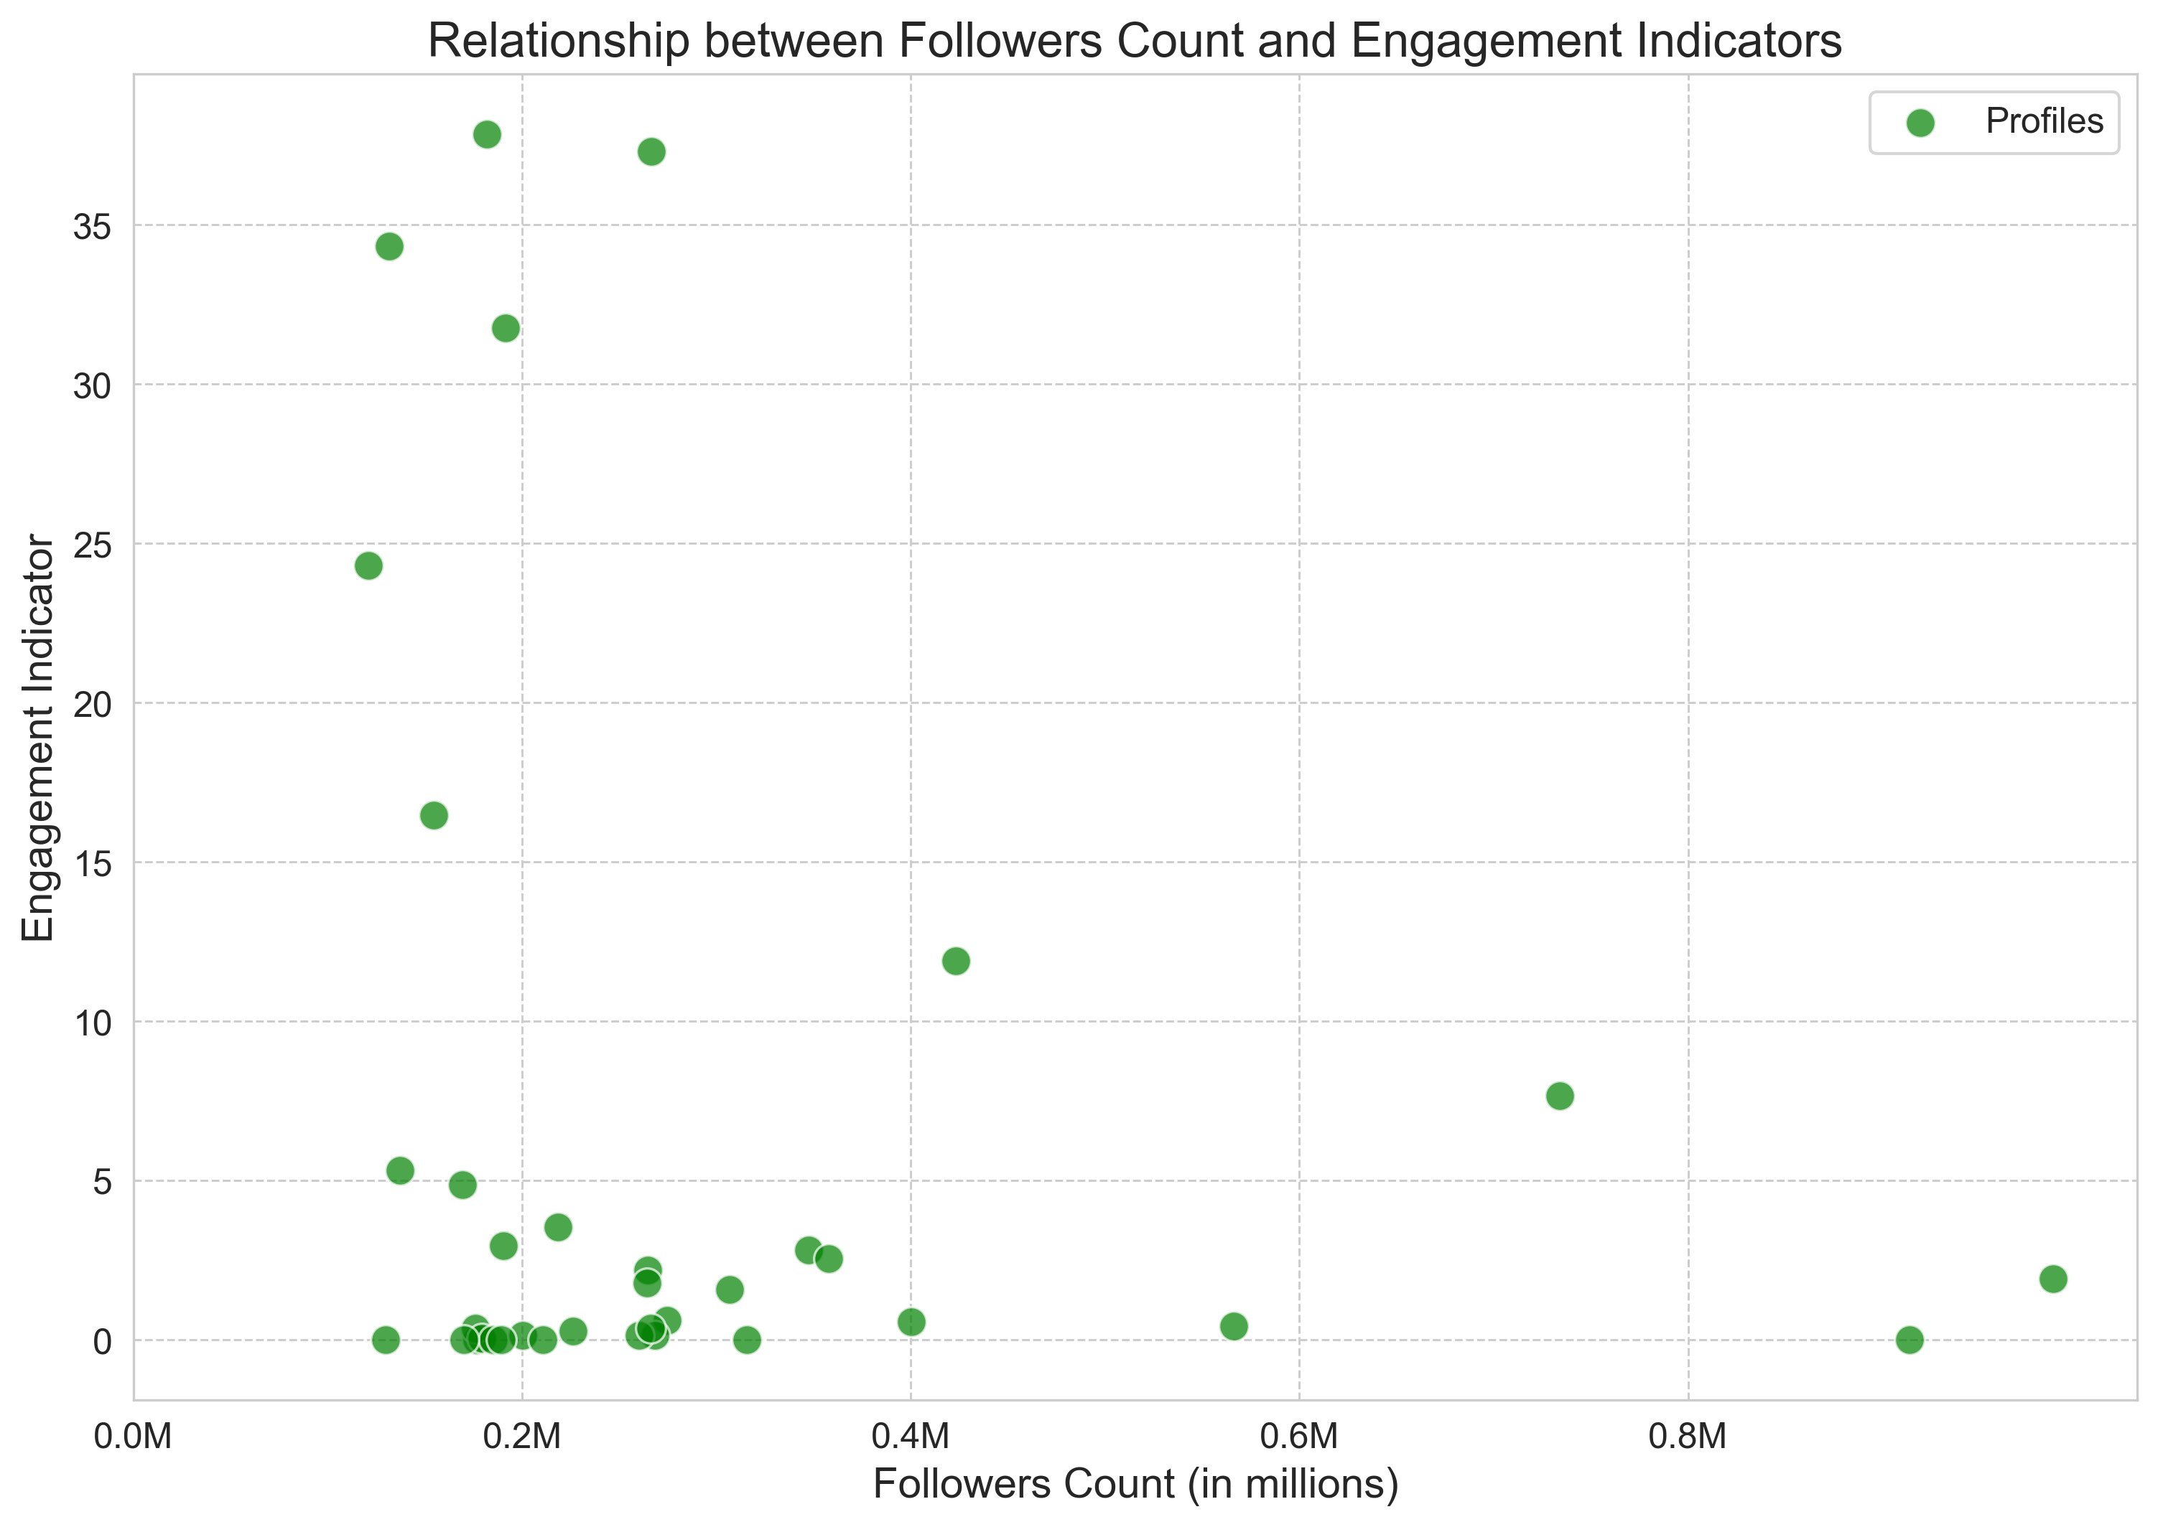
Follower Count vs. Engagement

Slide 5
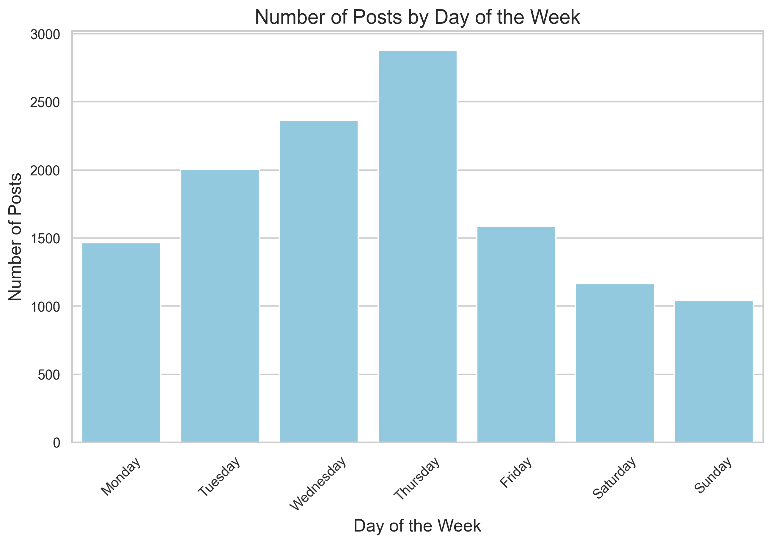
Posting habits by Day

Slide 6
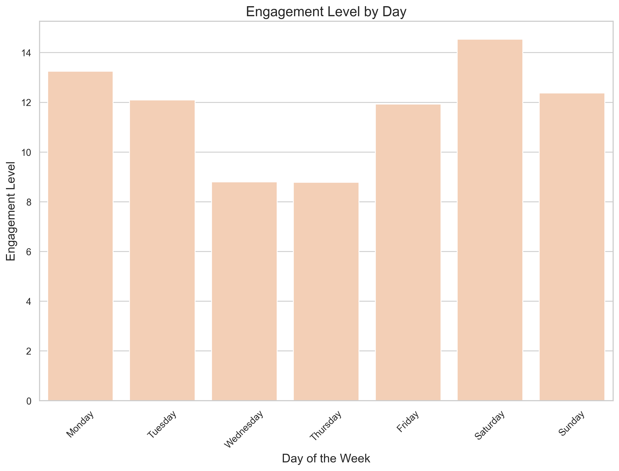
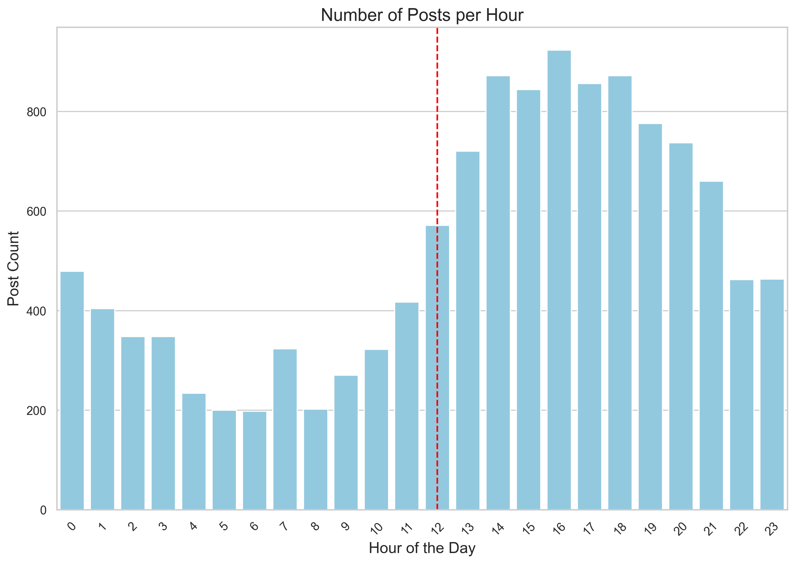
Engagement by day

Slide 7
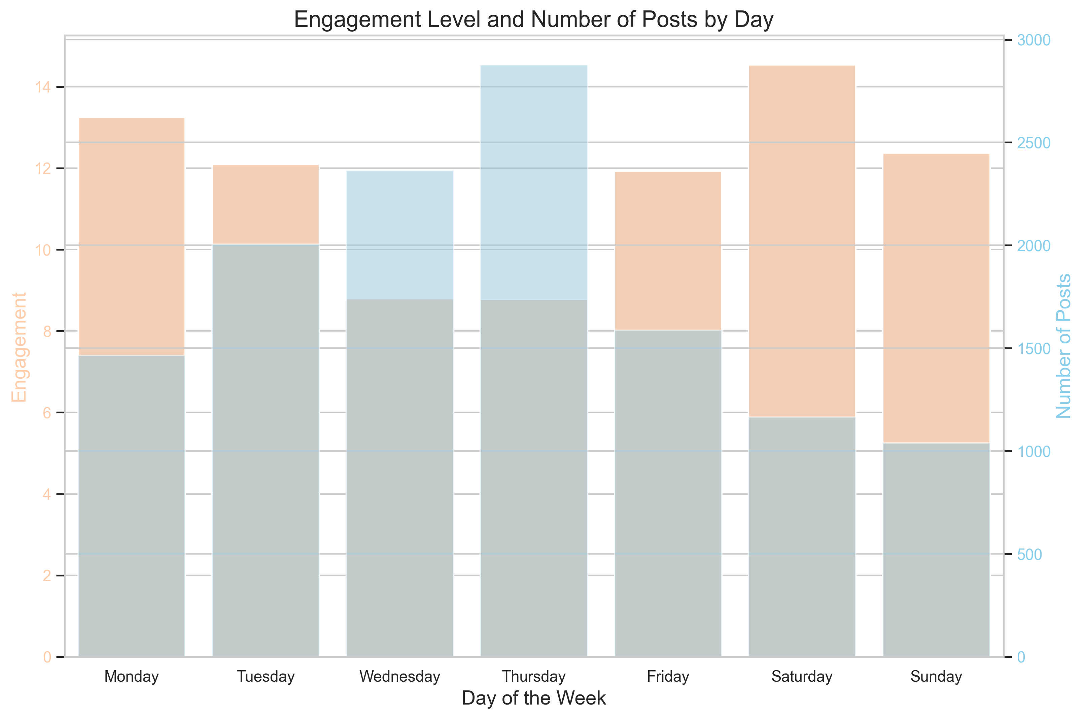
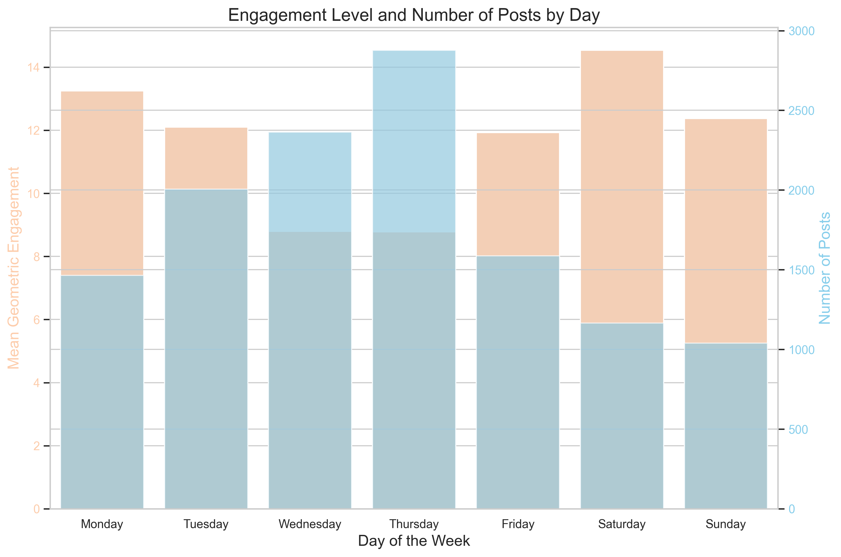
Engagement vs Posting (day)

Slide 8
Posting habits by Hour

Slide 9
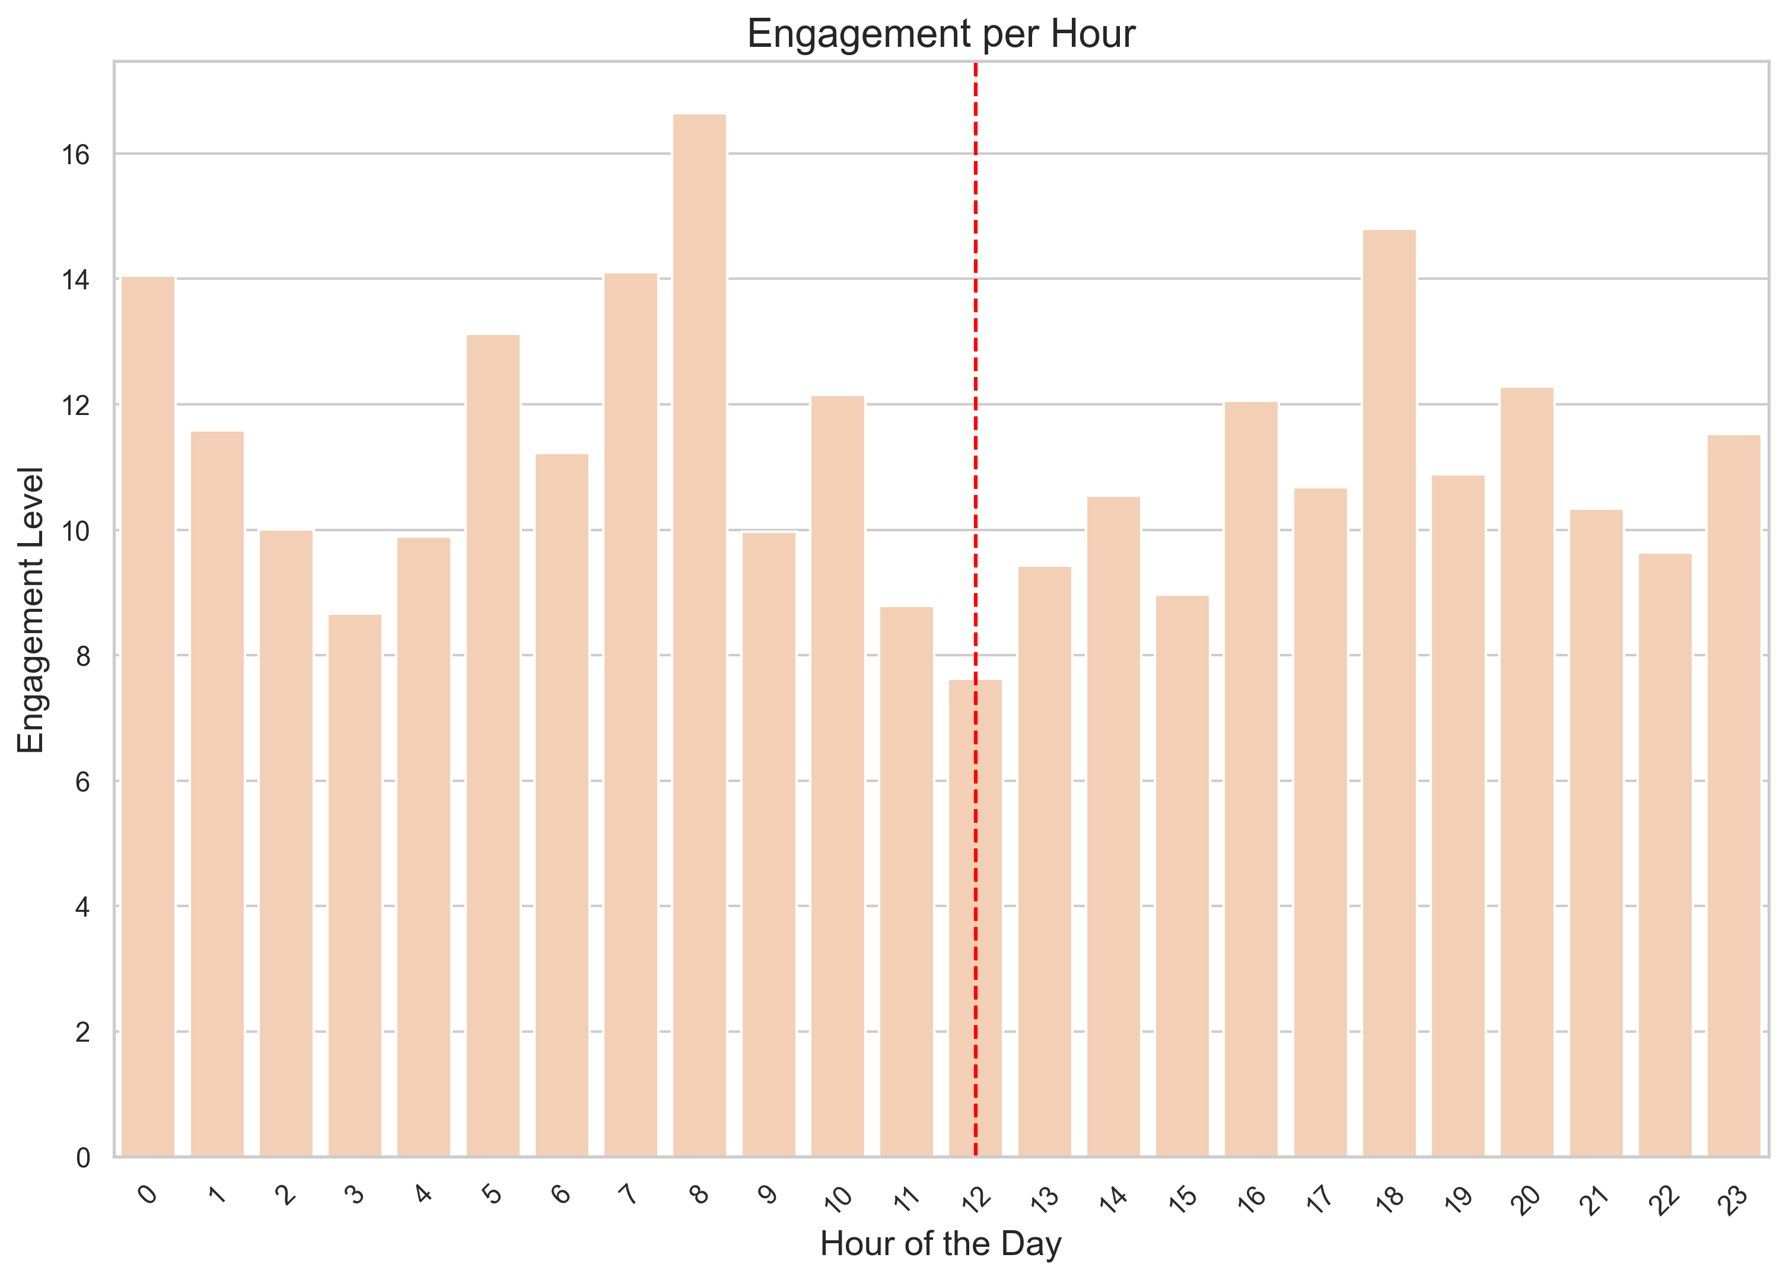
Engagement by hour

Slide 10
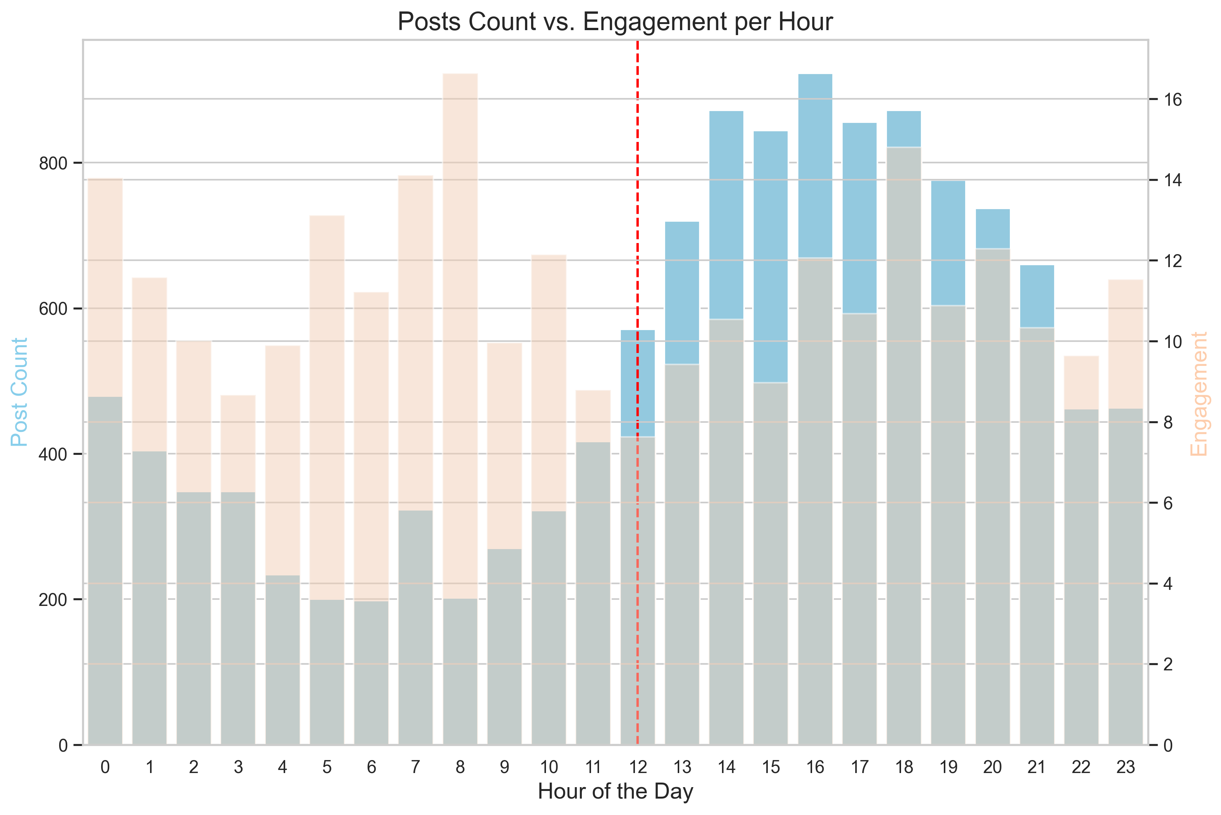
Engagement vs Posting(hour)

Slide 11
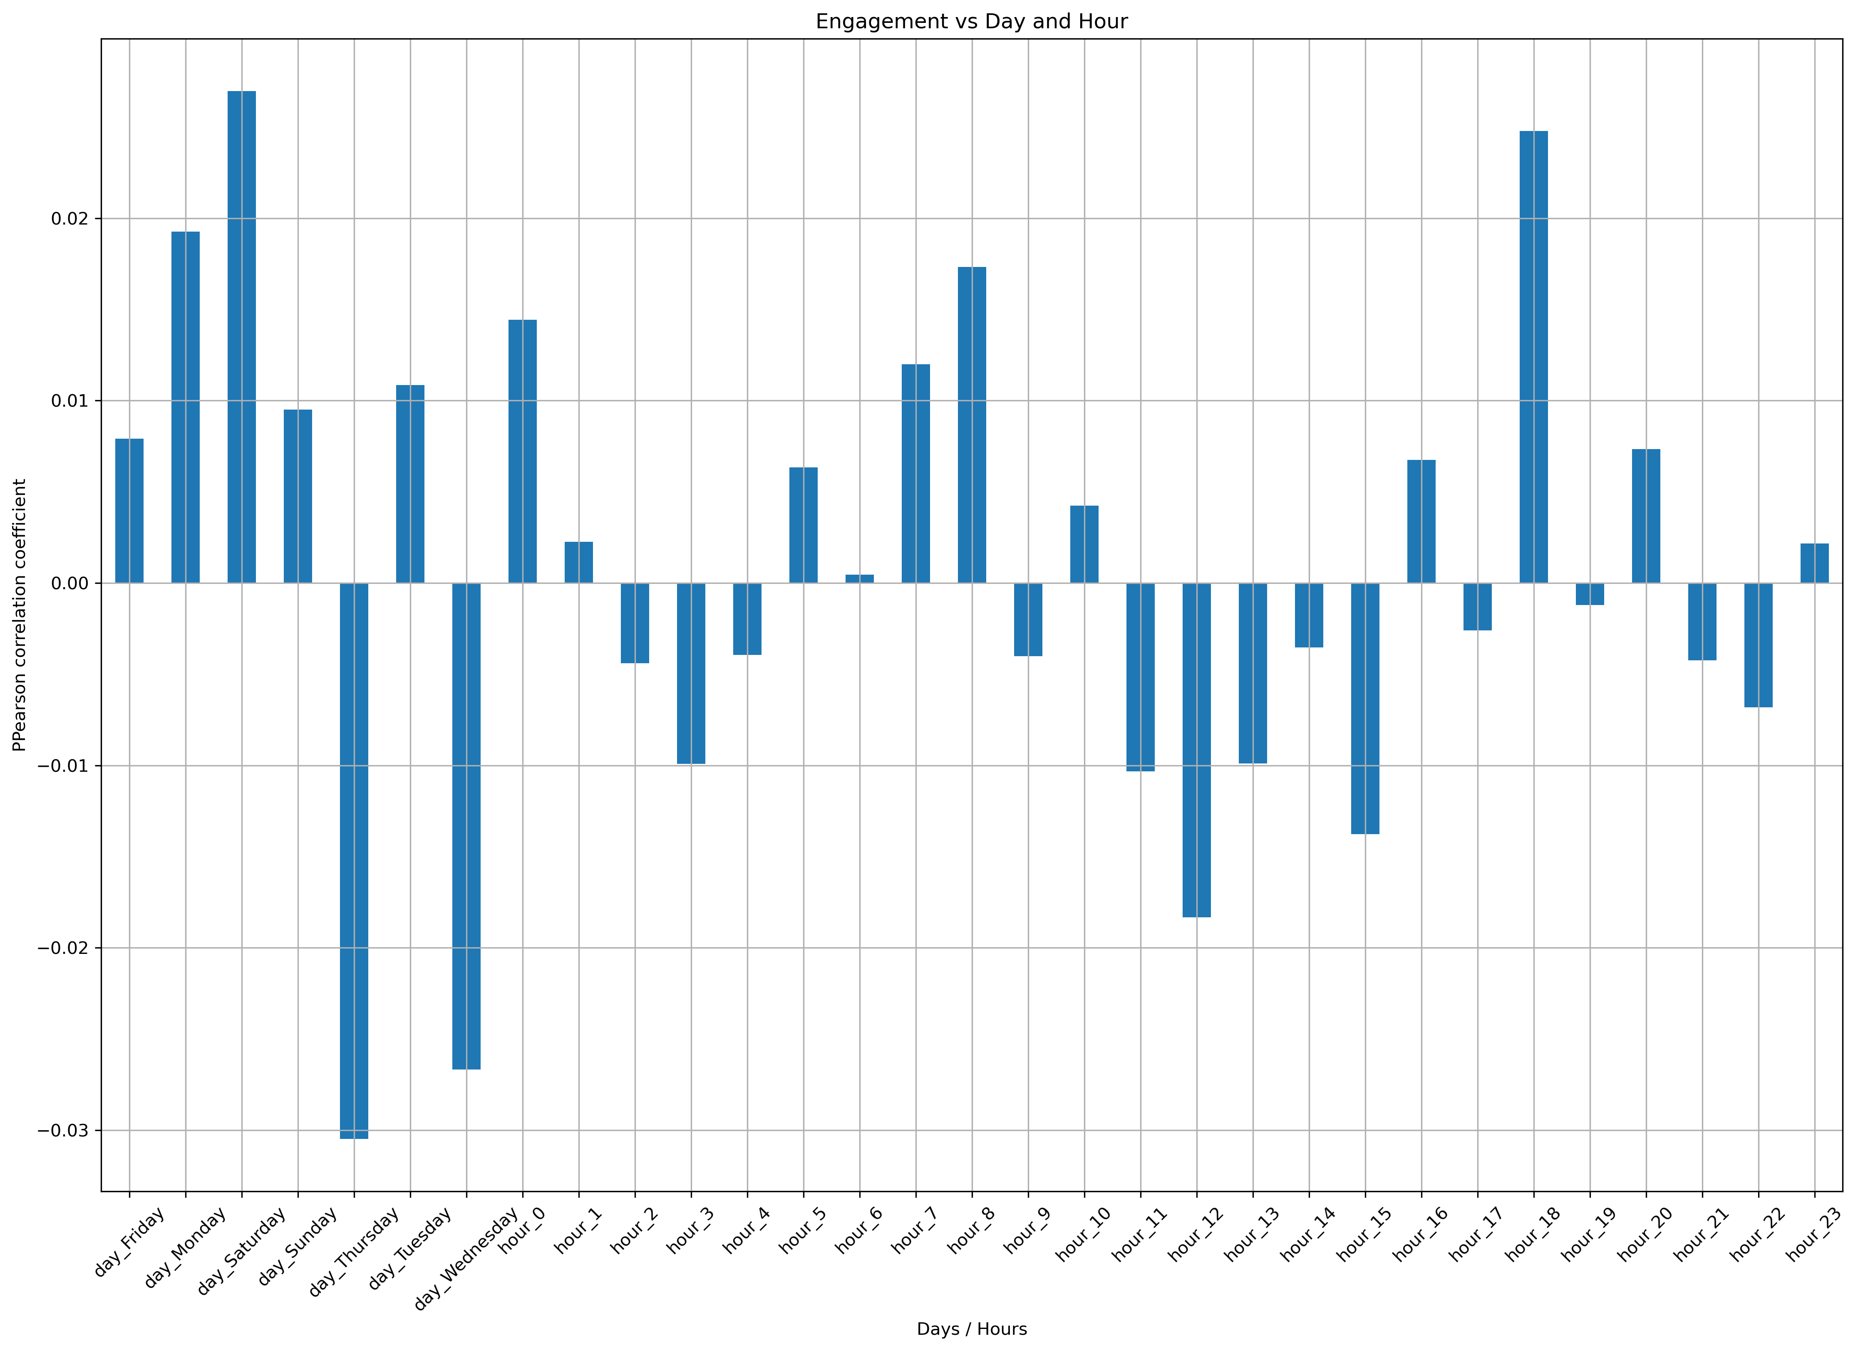
Correlation: Engagement vs Day/Hour

Slide 12
Conclusion
No clear correlation between amount of followers & engagement
High post frequency is not equal to high engagement
There is no high correlation regarding posting day and engagement
Saturday seems to be best day to post and Wednesday the worst
At 18:00 posting and engagement have the highest overlap

Slide 13
Outlook
Gather more information to compare profiles that have few followers to ones with a lot of followers
Compare our findings to engagement of other mastodon servers
Perform statistical tests to understand deviations
Further investigation on high engagement on Saturday and low on Wednesday

